Slide 1
Web Development
A Naga Harshini
20R11A0563

Slide 2
Topics Covered
Problem Statement
Technologies used
Output

Slide 3
Problem statement
To build a E-commerce website using HTML,CSS,Javascript(BASIC).Ecommerce refers to buying and selling of goods via the internet. E-commerce concept is rapidly growing as it has brought new ideas and opportunities in the field of business.

Slide 4
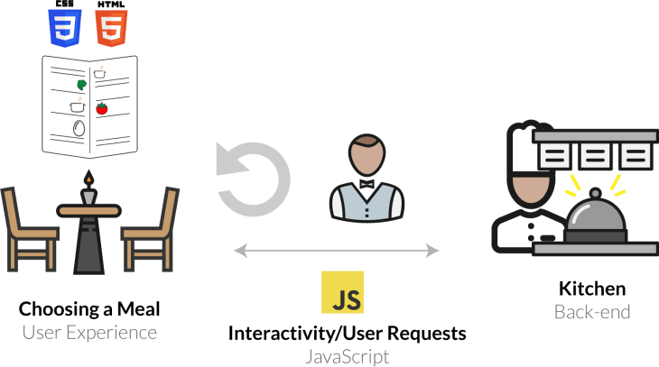

Slide 5
Technologies covered
HTML
CSS
CSS Framework(Bootstrap)
Javascript

Slide 6
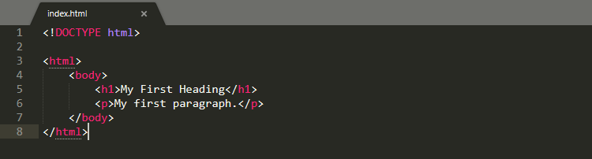
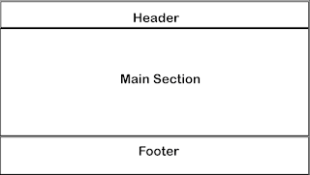
Hyper Text Markup Language (HTML)
HTML (or Hypertext Markup Language) is a computer language designed to create websites that later can be explored by anybody who accesses the Internet. HTML is normally employed to structure a web document. Since its initial release in 1991, HTML has undergone many updates. HTML5 released in 2014.HTML used for wrapping information.

Slide 7

Header
Section

Slide 8
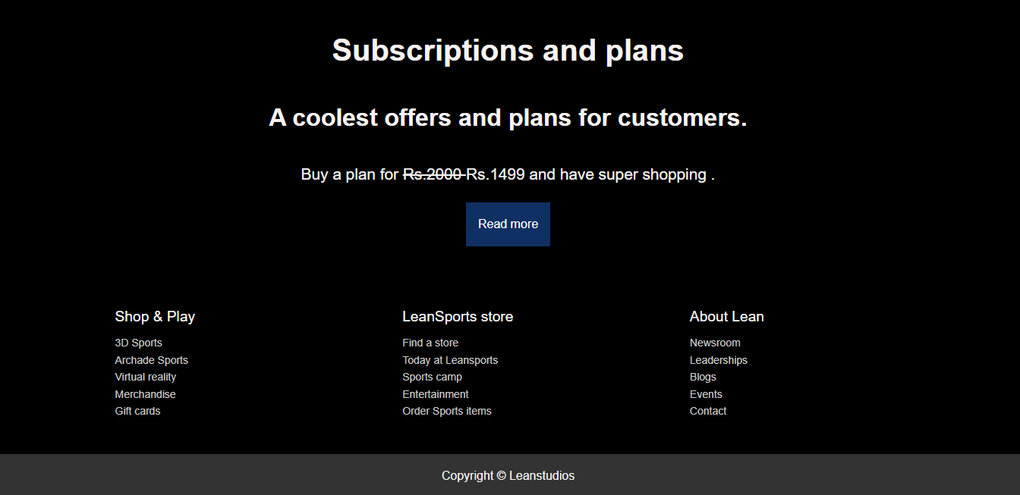
Footer

Slide 9
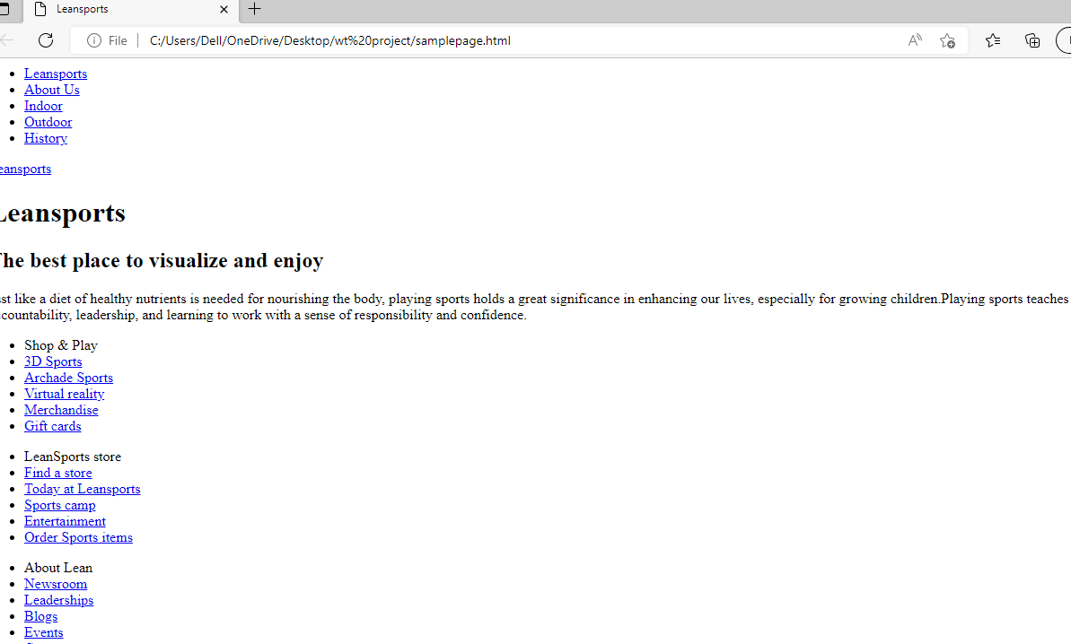
Website only with HTML

Slide 10
Cascading Style Sheets(CSS)
CSS (or Cascading Style Sheets) is a style sheet language. It’s applied to define how HTML elements are supposed to be presented on a webpage in terms of design, layout, and components of web page.In CSS we use selectors,declarations.
p{
font-size:24px;
color:blue;
}
Here p is selector,font-size,color are declarations.
The CSS can be implemented in three ways :
1)Internal CSS
2)External CSS
3)Inline

Slide 11
Javascript
Javascript is dynamically typed language.Due to popularity of Java its initial name livescript is changed to javascript.
It can be implemented as embeded,import,inject.
Embed- <script> /* some code */ </script>
Import- <script src="file.js" />
Inject- <button onclick="javascript: /*code*/">press me</button>

Slide 12
JavaScript contains a standard library of objects, such as Array, Date, and Math.
Client-side JavaScript extends the core language by supplying objects to control a browser and its Document Object Model (DOM).
Server-side JavaScript extends the core language by supplying objects relevant to running JavaScript on a server.

Slide 13
Bootstrap
A CSS framework is a set of default CSS and HTML files. Essentially, Bootstrap saves you from writing lots of CSS code, giving you more time to spend on designing webpages.
Responsive Grid
Responsive images
Components like navigation bars,dropdowns.

Slide 14


Slide 15
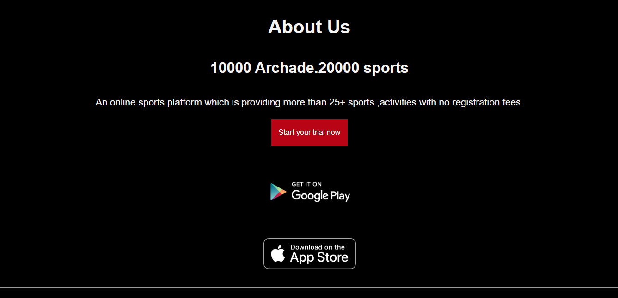

Slide 16
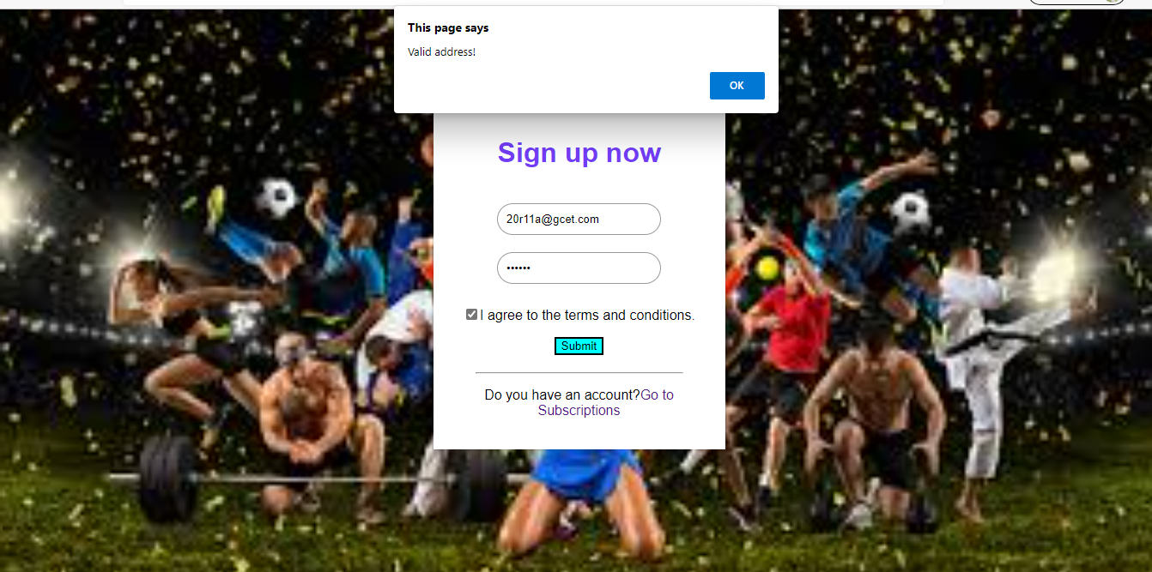

Slide 17
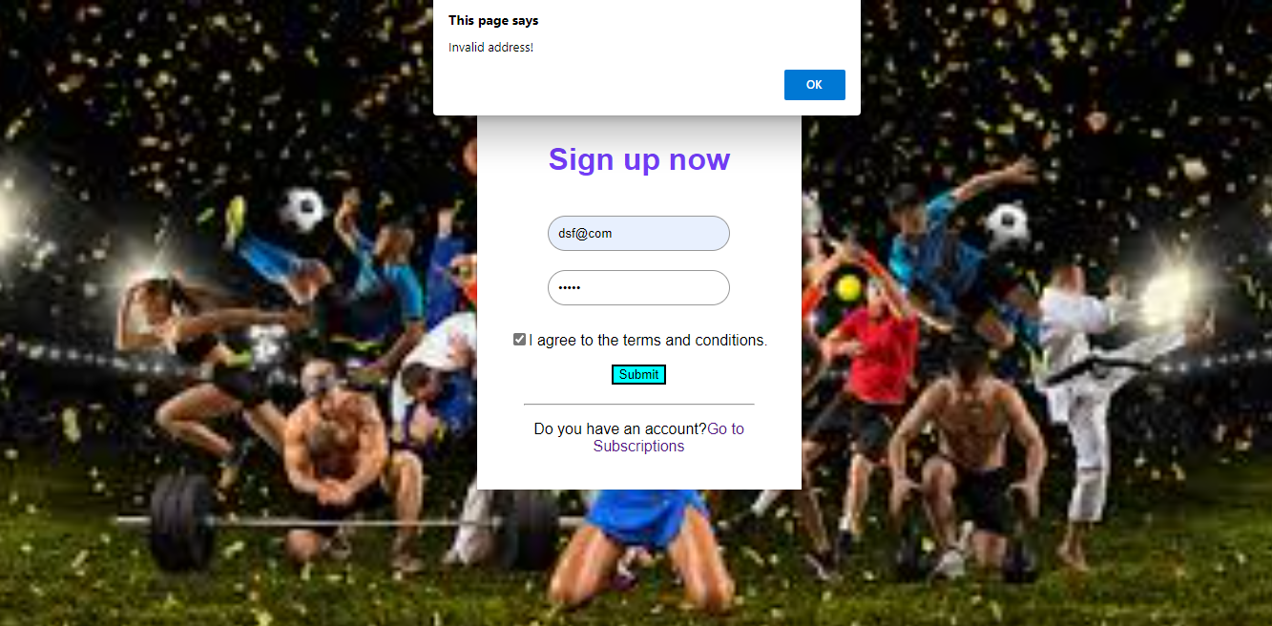

Slide 18
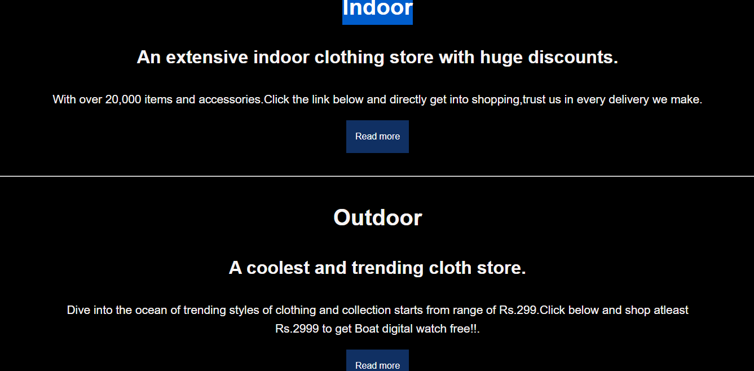

Slide 19
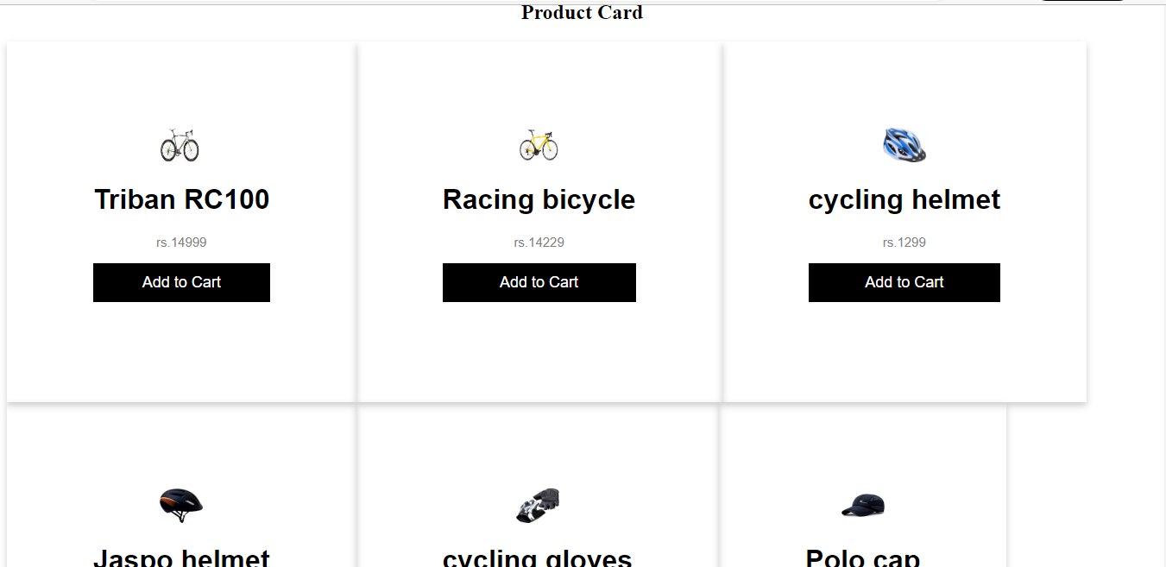

Slide 20
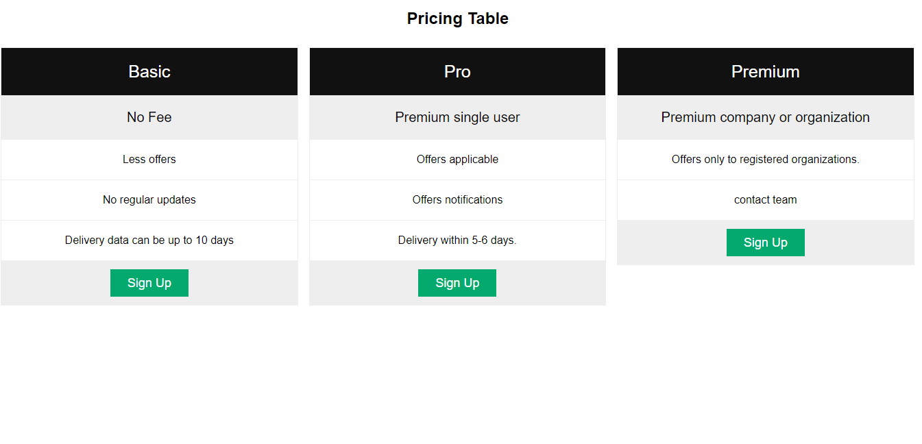

Slide 21
